Slide 1
Law of Arkansas Surface and Groundwater Rights
Edward Swaim
Arkansas Natural Resources Commission

Slide 2
Topics to be covered
The right to use surface water and groundwater
Limitations on surface water and groundwater rights
Arkansas Natural Resources Commission permitting and registration
Protecting surface water and groundwater rights
Current issues in water rights
Current and future water availability
Water use trends and issues
The Arkansas Water Plan

Slide 3
The Right to Use Surface water and Groundwater
Arkansas is “water rich”
We receive about 48 inches of rainfall per year
This translates to 138 million acre-feet of precipitation in an average year
We measure over 92 million acre feet of streamflow yearly
Abundance keeps us from fighting

Slide 4
Riparian Land
Land contiguous to a body of water
“Unity of title” vs. “source of title”
Right to use water is a property right
No “use it or lose it” requirement
Notes:
Source of title: rights can’t be regained
Unity of title: reunited land can regain riparian rights
No definitive adoption in Arkansas

Slide 5
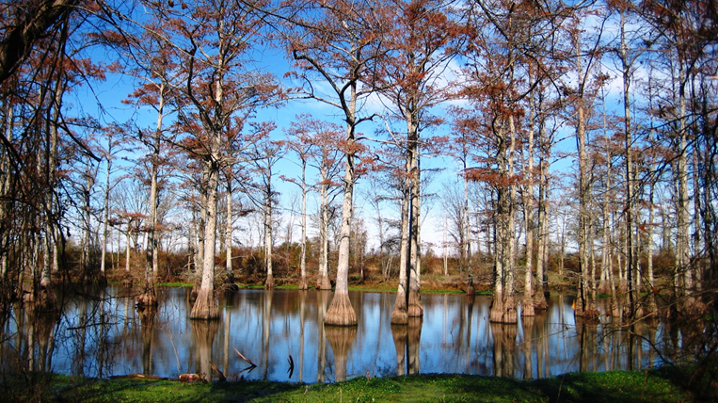

Slide 6
Common Law Riparian Doctrine
Purest form of rule: “Natural Flow”
Each property owner who has water flowing by his land is entitled to have the full flow of the stream going by without significant pollution from upstream

Slide 7
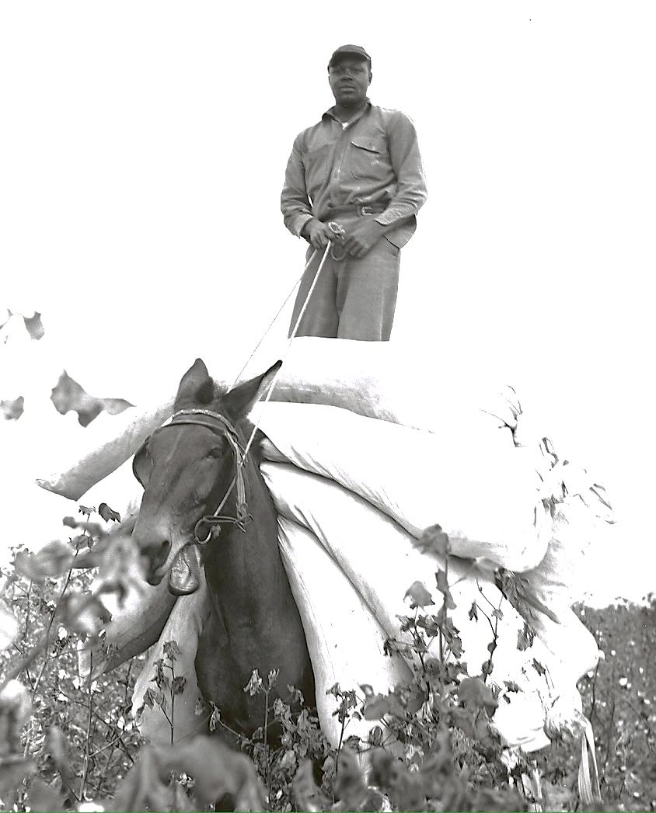
Progress Made Rule Impractical
Uses such as agricultural irrigation, mill ponds, and industrial use would diminish the “natural flow” to downstream neighbors
Wastewater discharge
Notes:
Natural flow details

Slide 8
Reasonable Use
Industrial development and technology required changes to riparianism
Consumptive and non-consumptive use limited by their reasonableness and whether they cause unreasonable harm to other riparians
Adopted in Arkansas in 1955 in Harris v. Brooks

Slide 9
Harris v. Brooks
Harris v. Brooks, 283 S.W.2d 129, 225 Ark. 436 (1955)
Farmers v. boat dock
Analyzed natural flow and reasonable use theory and adopted the latter
But, it is impractical to have the Arkansas Supreme Court set stop-pump lake levels!

Slide 10
Harris v. Brooks Rules
Domestic use superior
Other uses equal
Lawful use destroying another lawful use must yield or may be enjoined
Lawful use interfering or detracting from another lawful use requires determination of whether interfering use is reasonable or must be adjusted
Notes:
The Supreme Court had to balance these non-domestic, lawful uses
The Court determined that the irrigators had to stop pumping at 189.67 above sea level—this is the point where it determined continued irrigation would unreasonably harm the recreational/commercial use
Good illustration of how timing is not relevant to riparian rights

Slide 11
Groundwater
“…so secret, occult and concealed, that an attempt to administer any set of legal rules in respect to them would be involved in hopeless uncertainty, and would be, therefore, practically impossible.”
Frazier v. Brown, 12 Ohio St. 294 (1861)

Slide 12
Groundwater Cases
Jones v. Oz-Ark-Val Poultry Co., 228 Ark. 76, 306 S.W. 2d 111 (1957)
Adopted “American Rule” of reasonable use
Rejected “English Rule” of unlimited pumping
Lingo et al. v. City of Jacksonville, 258 Ark. 63, 522 S.W.2d 403 (1975)
Similar case with a municipal water system’s well field in a rural area

Slide 13
Protecting Surface and Groundwater Rights
“The right of a riparian owner to take water inheres in the soil and it is vested.” Thomas v. LaCotts, 257 S.W.2d 936, 96 Ark. 653 (1953)
“The riparian right does not depend upon use and is not lost by nonuse.” Thomas v. LaCotts at 940
Property right + Reasonableness of use = Successful defense of right to water

Slide 14
Legislation to Manage Water Rights
Dry periods bring court cases and legislation (As do floods)
State rejected Western-style allocation in the 1950s and 1980s
Laws to give predictability to water use:
Regulation of dams
Minimum streamflow
Allocation during shortage
Non-riparian transfer

Slide 15
Dams
Dams 25 feet or higher and impounding 50 acre-feet or more of water must be permitted
Hazard classifications bring inspection and emergency action requirements
Can only impound “surplus water” and must release water at a rate that doesn’t cut off lower riparians

Slide 16
Minimum Streamflow
Quantity required to meet the largest of instream flow need, including interstate compacts, navigation, fish and wildlife, water quality, and aquifer recharge
Can be set by rulemaking (Ark. River 1990 White River 2009) or case-by-case
Triggers allocation

Slide 17
Non-Riparian Permitting
Pre-1985 not legal, but not quite illegal
Harrell v. City of Conway, 271 S.W.2d 924, 224 Ark. 100 (1954) Surface water
Lingo et al. v. City of Jacksonville, 258 Ark. 63, 522 S.W.2d 403 (1975) Groundwater
Public utilities had no inherent right to anything beyond riparian use on the intake and well site, but, no big deal if there’s no shortage

Slide 18
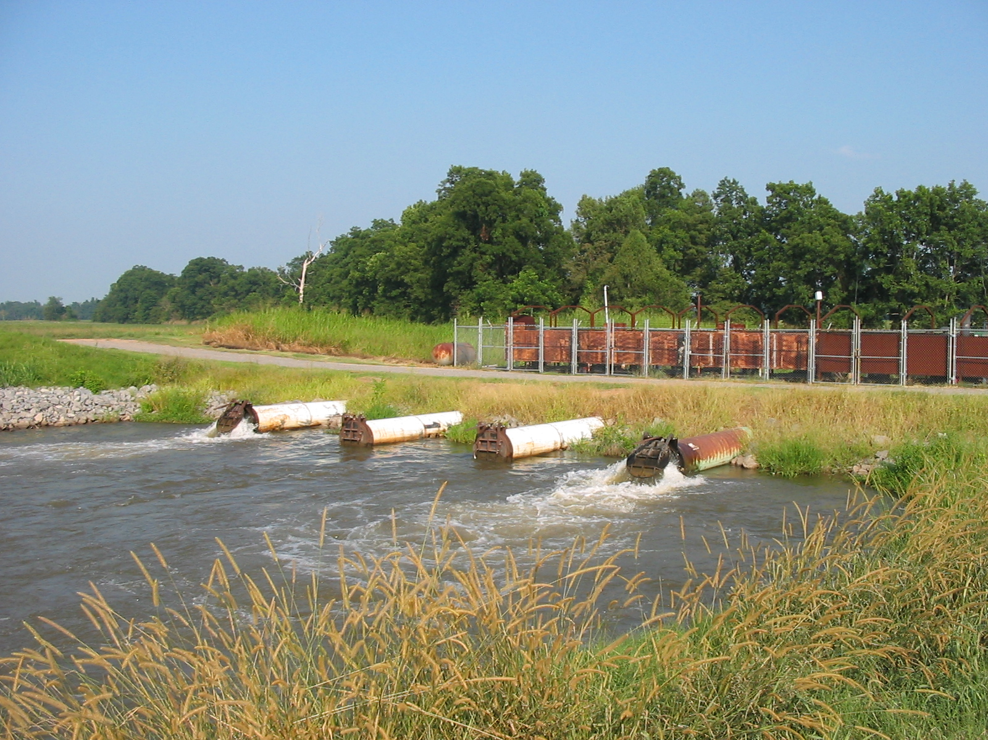
Plum Bayou Irrigation Project

Slide 19
Non-Riparian Permitting Law
1985 Breakthrough to allow a permitting process to move our abundant surface water
Current and future riparian rights, aquifer recharge, fish and wildlife needs, navigation, and interstate compacts are protected
25% of everything above that is permittable
Non-riparian use is inferior to riparian use

Slide 20
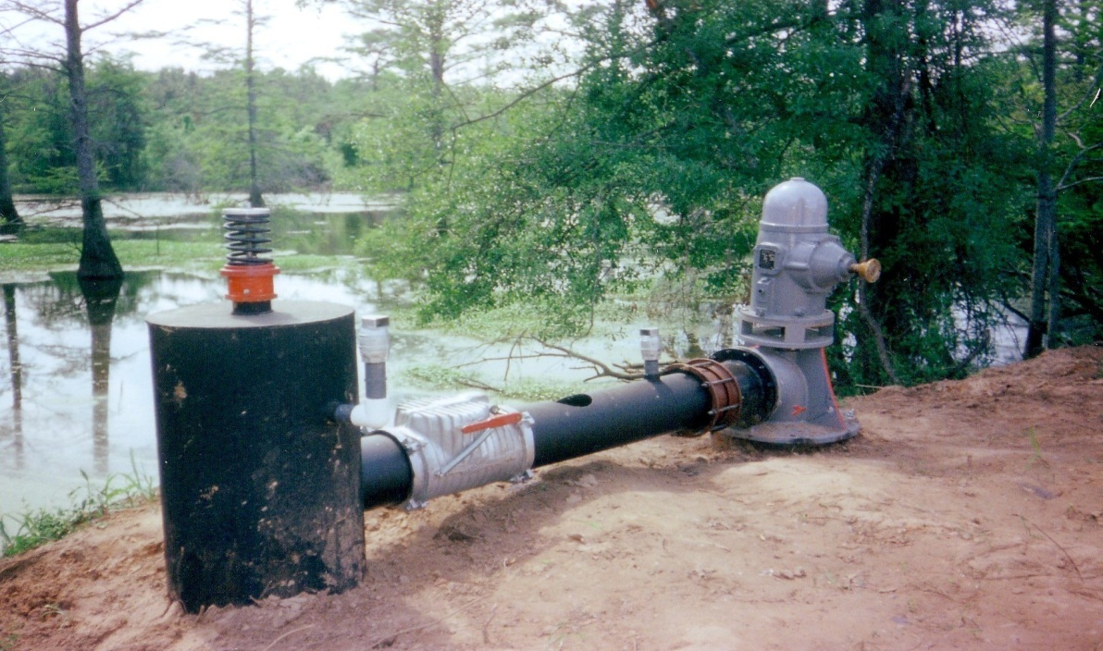
Water Use Registration/Reporting
Annual registration with local conservation district or with ANRC
Surface and groundwater
Exceptions
Notes:
Registration functions as a passive permitting system
Surface water diverters are required to register their diversion by quantity, location, type of use and name of user on an annual basis with the Arkansas Natural Resources Commission. Exceptions to this rule are withdrawals of less than one acre-foot per year, diffused surface water, and natural lakes or ponds in exclusive ownership of one person. However, if that lake or pond is fed by or refilled by a well or other surface water source that source may need to be registered. The Commission uses data from registration to allocate of water during times of shortage and as a basis for determining the state’s overall usage and water needs for inclusion in the Arkansas Water Plan
Non-domestic ground water use or use from wells with a maximum potential flow rate of greater than 50,000 gallons a day must be registered with the Commission. The Commission uses the information from registration in its comprehensive ground water protection program, to designate critical ground water areas, and, if it becomes necessary, to establish ground water rights within critical areas.
In many counties, the Commission has delegated the registration program to Conservation Districts. Registration fees, $10 per well or diversion, are used in part by districts to develop cost-share, educational, and informational programs.
Since water use registration is to be used in determining rights when surface water use is allocated during a shortage and to assign groundwater rights, it is vital for the water user to register use on time and accurately.

Slide 21
Allocation of Surface Water
1957 effort by the legislature to streamline Harris v. Brooks process
Arkansas Code section 15-22-217
Step one: Declare a shortage: “not sufficient water in a stream to meet all beneficial uses”
Then a notification and adjudication process starts

Slide 22
Usable Without Allocation
< 1 acre-foot (325,900 gallons) per year
Diffuse surface water
Captured water
Exclusively owned water
Tailwater
Non-consumptive use
Intermittent streams

Slide 23
Reserved Uses
Water use that can’t be limited through allocation:
Domestic and Municipal domestic
Minimum streamflow
Federal water rights
AGRICULTURE (2013)

Slide 24
Allocation Preferences
Sustaining life
Maintaining health
Increasing wealth

Slide 25
Allocation Hierarchy
Registered riparian use
Non-registered riparian, but used
Non-riparian permitted INTRAbasin
Non-riparian permitted INTERbasin
Out-of-state transfer
Never used, never registered riparian

Slide 26
Regulation of Groundwater Use
1991 - Groundwater Protection and Management Act, Arkansas Code 15-22-901, et seq.
Long, appealable process
Grandfathering
Alternative surface water supplies must be available or can be made available
Issuance of “water rights”

Slide 27
Current Water Rights Issues
Groundwater availability
Water quality
Interstate transfers
Infrastructure condition and financing

Slide 28
Current and Future Availability
Current needs are being met
Water is there for future needs, but maybe not from the same source
Water use reporting, stream gauging, and aquifer measurements are some of our tools

Slide 29
Water Use Trends and Issues
Population (small percentage of overall demand and getting more efficient)
Crop irrigation – Some rise expected
Industry – Declining with loss of paper mills
Hydraulic fracturing – Never a large demand, and has slowed dramatically

Slide 30
This is where we analyze supply, demand, and “gaps”
Arkansas Code section 15-22-503
“A comprehensive program for the orderly development and management of the state’s water and related land resources”
1969 – Authorized
1975 Plan updated in 1990 and 2014
Rulemaking complete this week!

Slide 31
State and Regional Water Management and Planning
Edward Swaim
Arkansas Natural Resources Commission

Slide 32
Topics to be covered
Surface water resources
Groundwater resources
Regional water planning
Interstate water compacts
Future projections and challenges

Slide 33
Surface Water Resources
Excess water calculations were completed for 9 major river basins and 23 smaller river basins within the larger basins

Slide 34
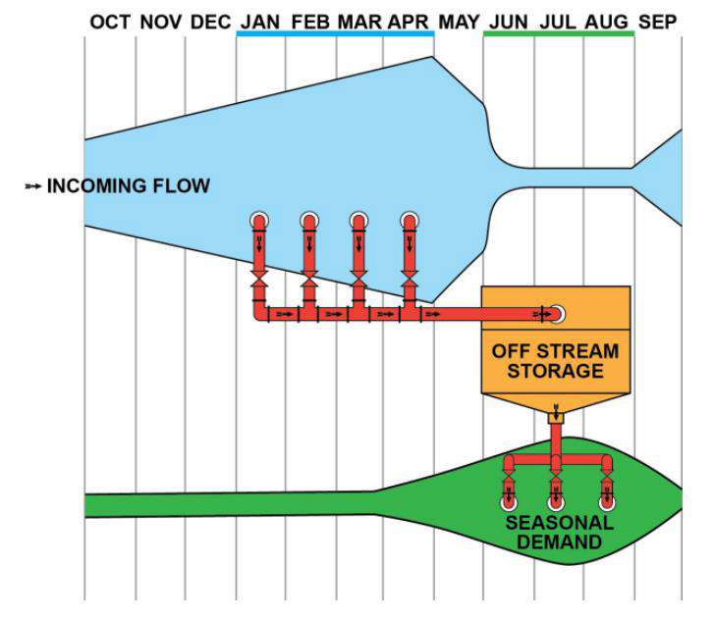
Surface Water Availability
We have more than enough surface water on an annual basis to meet all needs-in-stream and out-of-stream
If we can build the diversion, storage, and distribution infrastructure, there is plenty of water physically and legally available (“excess surface water”) in most areas to reduce groundwater use to “sustainable yield”

Slide 35
26 million AFY
92 million AFY
9 million AFY
57 million AFY

Slide 36
Groundwater Resources
Groundwater supplies 71% of our water
Arkansas is now the number two groundwater user
About 60% of our statewide use is unsustainable
Our knowledge is now a long way from viewing groundwater as “secret, occult, and concealed”
USGS Mississippi Embayment Regional Aquifer Study (MERAS)

Slide 41
Regional Water Planning
Water Plan update’s largest single section is 1,085 pages of regional reports
Five planning regions to address geographic, water supply and use differences, economics, and county lines
Will divide further in the future as planning continues

Slide 43
Arkansas River Compact
Arkansas River Compact
Equitable apportionment of Arkansas River between Arkansas and Oklahoma
60% of the current runoff delivered to the downstream state
Water quality hottest topic

Slide 44
Red River Compact
Arkansas, Oklahoma, Texas, and Louisiana
The Ouachita River, Bayou Bartholomew, Bayou Macon, and Boeuf River basins are included in Reach IV
Current difficulty in interstate streams in SE Arkansas during summer months when rainfall is low and demand is high

Slide 45
Future Projections and Challenges
Groundwater gap of over 8 million acre-feet per year is our biggest supply challenge
Threat to the Sparta
Our analysis in the Water Plan shows a 25% reduction in crop irrigation demand possible through conservation
The remainder must be made up with surface water

Slide 46
Using Excess Surface Water
Law already provides for the use of that much excess, but not all in the eastern part of the state
We will study whether % permittable water can be increased safely in East Ark.
It will cost about $8 billion to build enough projects

Slide 47
Infrastructure
In the next 10 years:
Public water infrastructure needs $5.74 billion
Public wastewater infrastructure needs $3.76 billion
Our most useful tool is general obligation bonds
May see a bond issue in front of the General Assembly in 2017

Slide 48
Drought Planning
NDMC 2013

Slide 49
Interstate Transfer Requests
Texas is thirsty
Texas has planned to look to Arkansas for water since at least the 1960s
Requests have started coming in, including one to go to the Mississippi River
Law disfavors interstate transfer and requires a long, involved process of review

Slide 50
Water Quality
Unregulated, non-point source sediment and nutrient runoff
Increased state investment
Row crop Phosphorus index
Discussion of exploring need for nutrient management planning outside NW Arkansas

Slide 51
Data Gathering and Quality
Continued financing of stream gauging
Good basic information gathering, such as well measurements
Improving water use data for crop irrigation
Acreages
Metering more water use to improve estimated use

Slide 52
Thank you
arkansaswaterplan.org
Edward Swaim, Arkansas Natural Resources Commission
101 East Capitol Avenue, Suite 350
Little Rock, Arkansas 72201
501-682-3979
edward.swaim@arkansas.gov

